Slide 1
Enhancing
Digital Publications
With Alpheios
Bridget Almas
Tufts University
August 6, 2018
@Alpheios
@BridgetAlmas

Slide 2

Alpheios builds evidence-based open-source software to support the worldwide study of classical languages and literatures.
Notes:
Our goals for Alpheios are very broad. Our mission is enabling the enjoyment and study of classical languages and texts, and also to begin to understand how and why people learn languages, how this changes the brain, and what are the individual differences that lead to learning success or failure. By providing free, open source software tools and libraries, we hope also to be a shared resource for the wider community of digital classics.

Slide 3
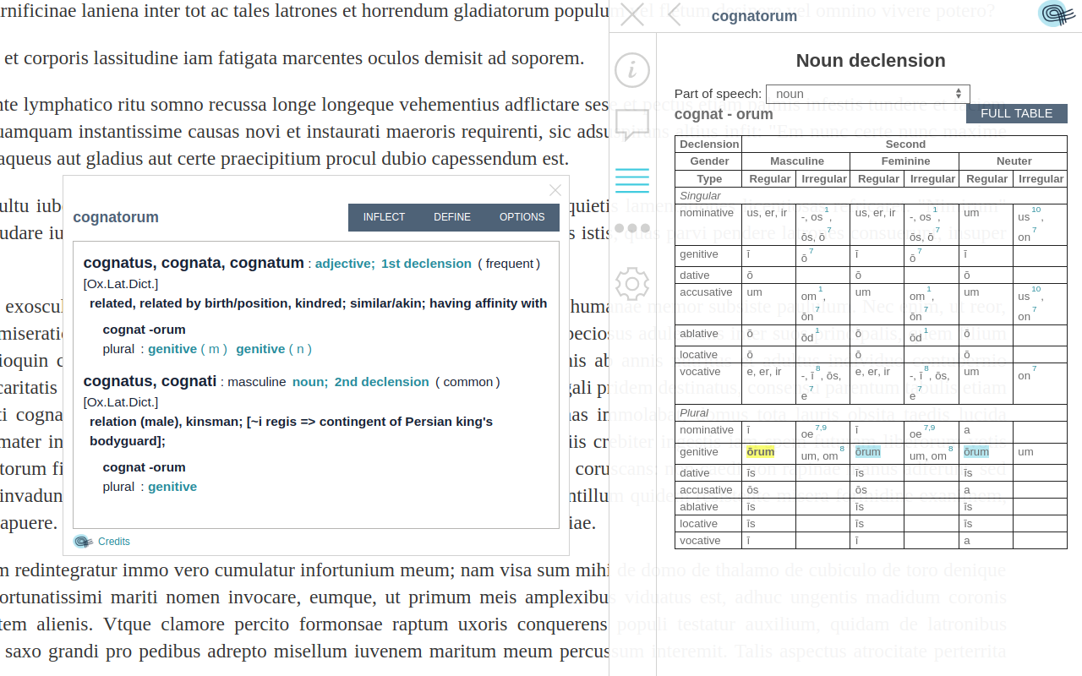
Notes:
Through its browser extensions, Alpheios works with any text, anywhere on the web, as long as it is in well formed HTML and Unicode. It provides morphological analyses, dictionaries, grammars and inflection tables for word study. A challenge for access and understanding of primary source material in classics is the ability to decipher the ancient text. Alpheios aims to provide in-context aids to address this.

Slide 4
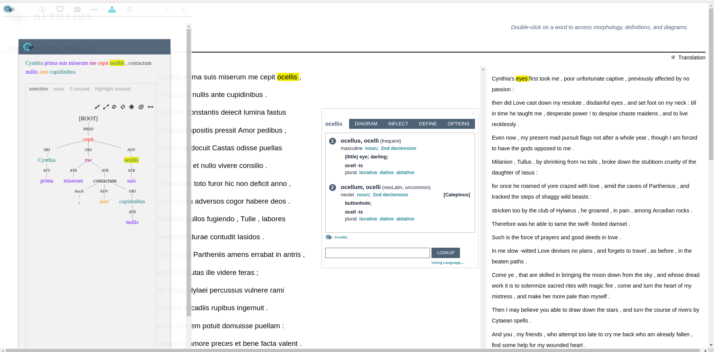
Notes:
Alpheios can also work with texts which have been annotated with treebanks and translation alignments. The libraries can be embedded by text publishers directly within a page, if you don’t want your users to have to install a browser extension to work with it. We are also currently working on mobile friendly solutions and other sorts of annotations and resources, such as audio.

Slide 5
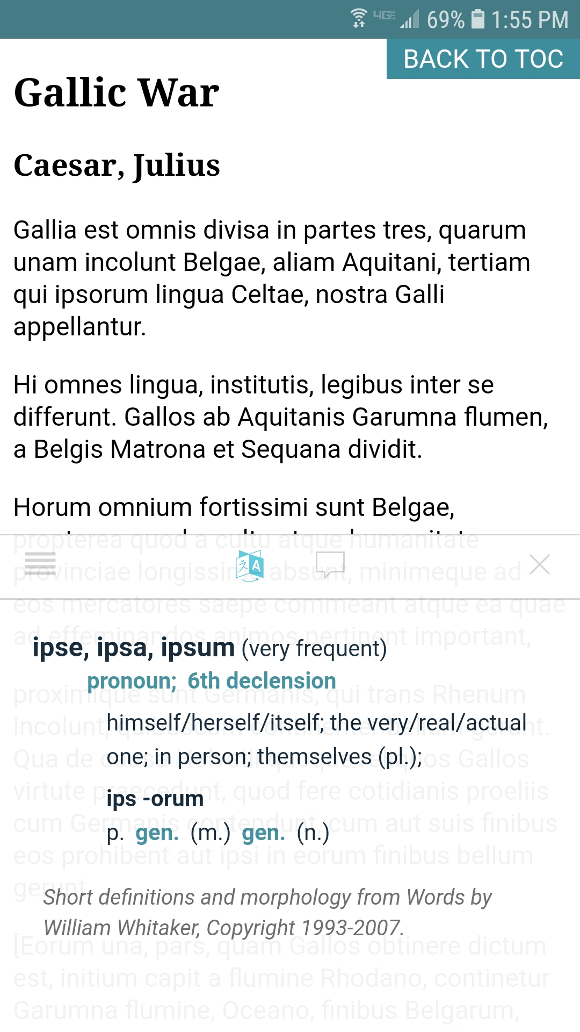
Notes:
This is a look at the Alpheios mobile prototype

Slide 6
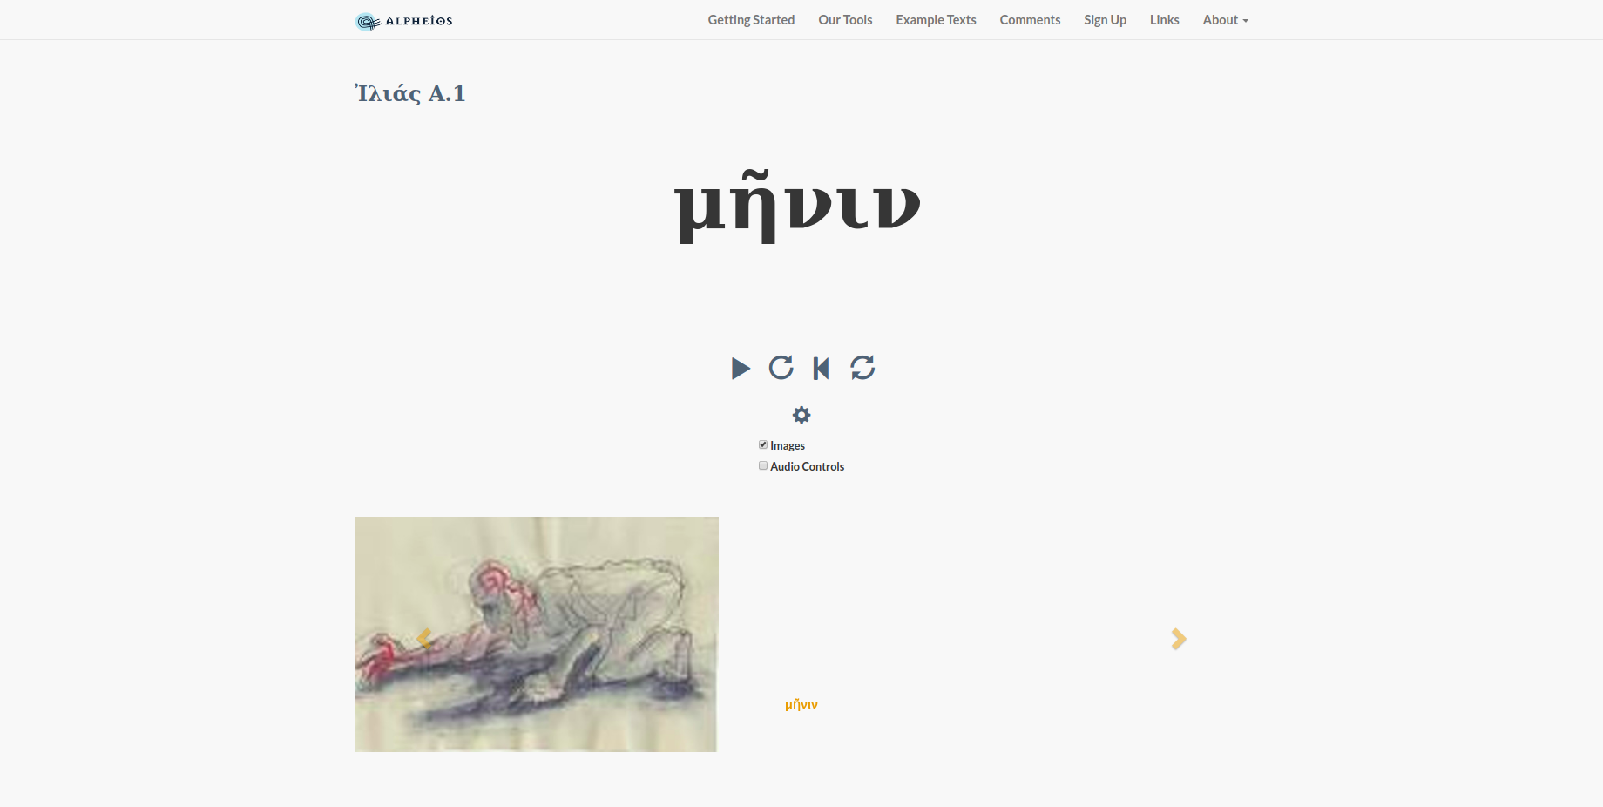
Notes:
This is a glimpse of our poetry prototype, which aligns a recitation of Homer’s Iliad with the text and images.

Slide 7
Embedding Alpheios
Embed the stylesheet in your HTML page

Slide 8
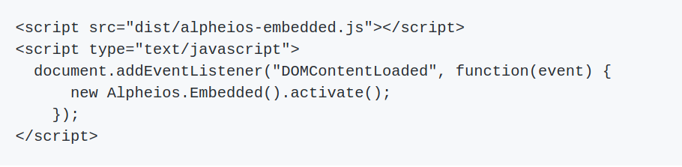
Embedding Alpheios
2. Add the script to your HTML page

Slide 9
Embedding Alpheios
3. Add an anchor element to your HTML page to activate the library. This element should have 2 data attributes:
data-selector: a CSS selector string for selecting elements on the page which should have Alpheios activated for them
data-trigger: the name of the DOM event which triggers the functionality

Slide 10
Embedding Alpheios
4. Configure specifics for your site
E.g. setting the anchor element and location for the popup:

Slide 11
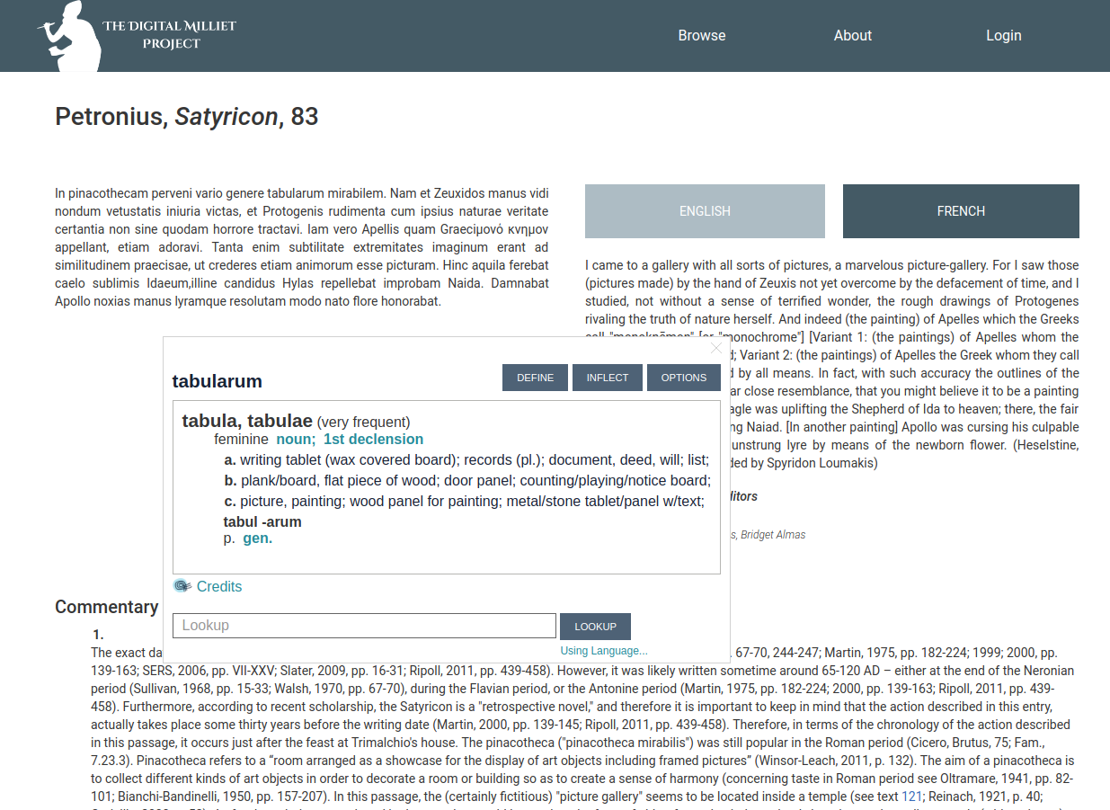
Notes:
For example, Alpheios can be easily added to a publication such as the Digital Milliet to provide language assistance for references from the primary source texts. The Alpheios interface elements can also be branded with colors and styles according to site preferences. Even if you don’t embed Alpheios in your publication, it can still be used via the browser extensions. Ultimately we expect to be able to extend the tools to support a wide variety of associated resources for texts -- including images, audio and other related resources.

Slide 12
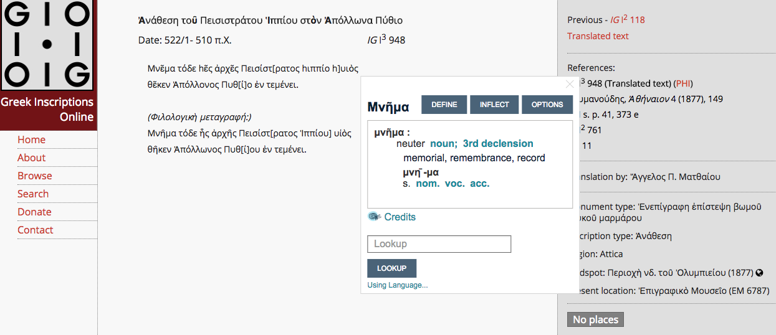
Notes:
Here’s another example, of using Alpheios to augment the resources of Greek Inscriptions Online. We would love feedback from those of you working on Art History on what sorts of features would be most useful in that domain.
aq11

